Slide 1

Sales Project
BY : Mostafa Zanoun

Slide 2




In This Presentation
Excel Process (Adding new sheet with more related info & Pivot Tables Analysis)
SQL queries (Creating DWH Tables Fact and Dimensions & Star Schema)
SSIS Pipelines
Power BI Dashboard of Sales

Slide 3
Excel Process

Slide 4
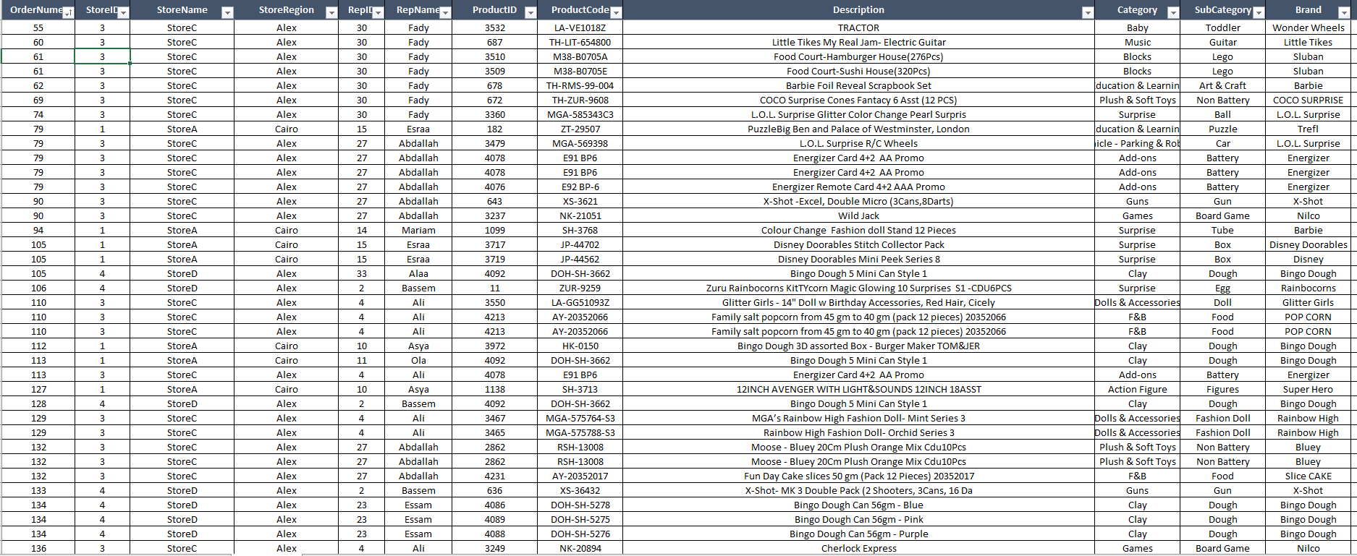
New sheet with VLOOKUP to get more info
VLOOKUP Example of adding info about store

Slide 5
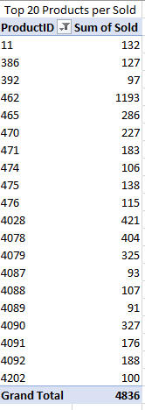
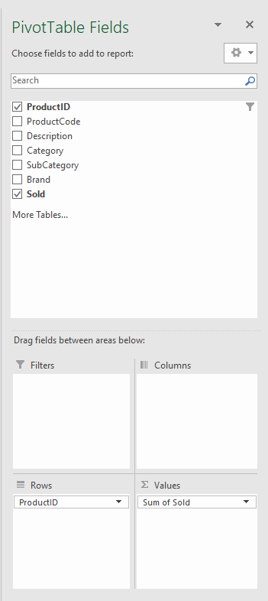
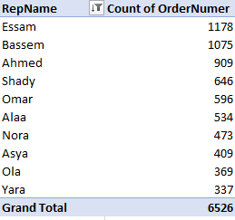
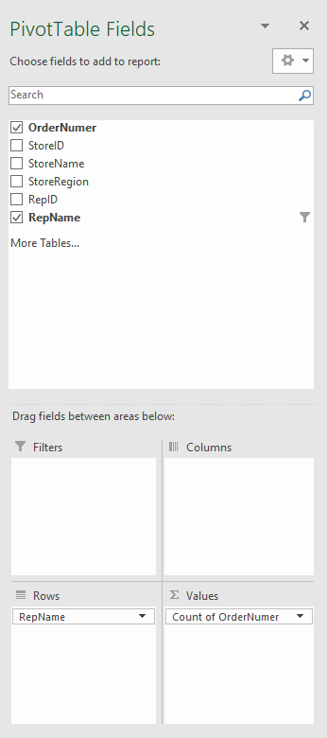
Analysis with Pivot Tables
Top 20 Products per Sold
Top 10 Reps per Count of Order number

Slide 6
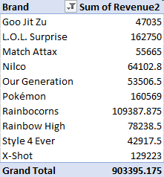
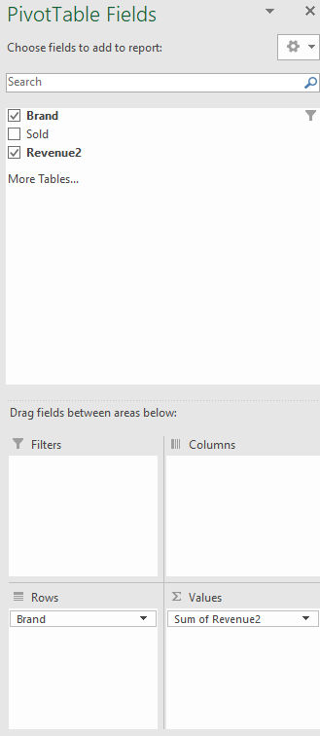
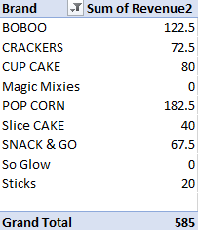
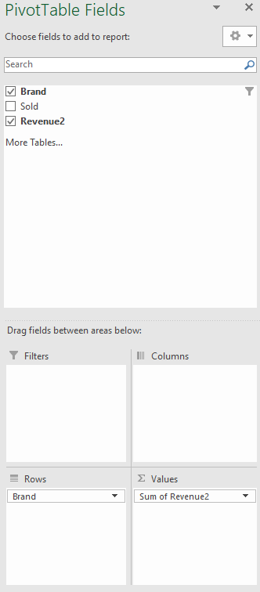
Analysis with Pivot Tables
Top 10 Brands Per Value
Worst 10 Brands Per Value

Slide 7
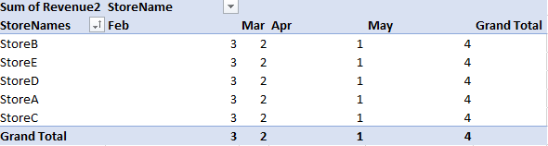
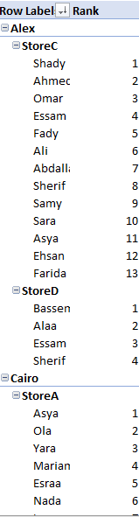
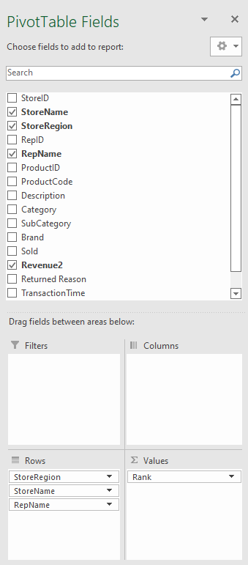
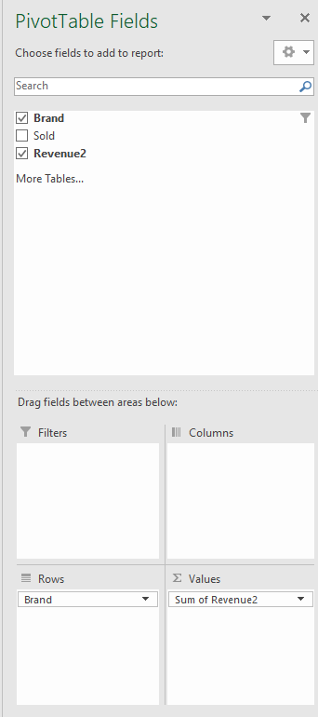
Analysis with Pivot Tables
Rank Month in Each Stores
Rank Reps in each Stores

Slide 8
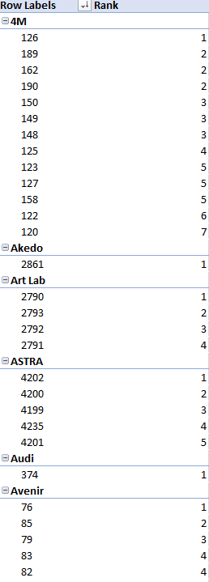
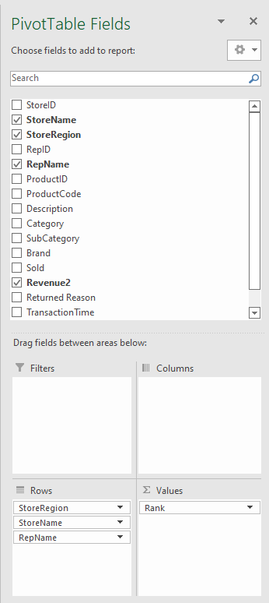
Analysis with Pivot Tables
Rank Products in each Brand

Slide 9
MS SQL SERVER Process

Slide 10
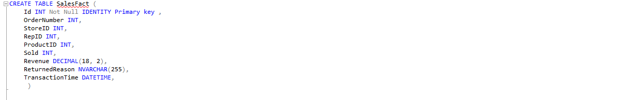
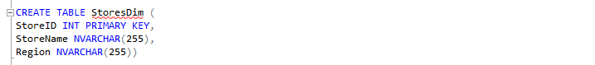
Queries of creation Table of DWH
Sales Fact Table query
Stores Dim Table query
Reps Dim Table query

Slide 11
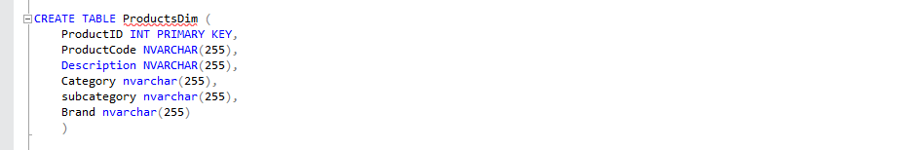
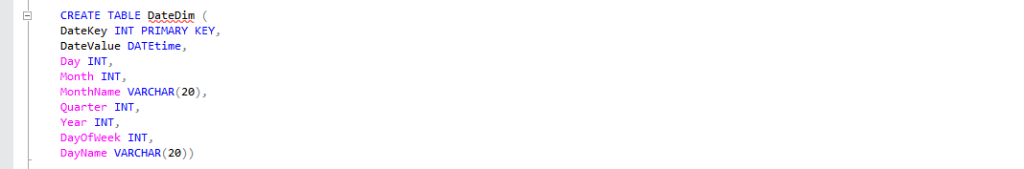
Queries of creation Table of DWH
Products Dim Table query
Created Date Dim Table to relate it our dates in sales fact

Slide 12
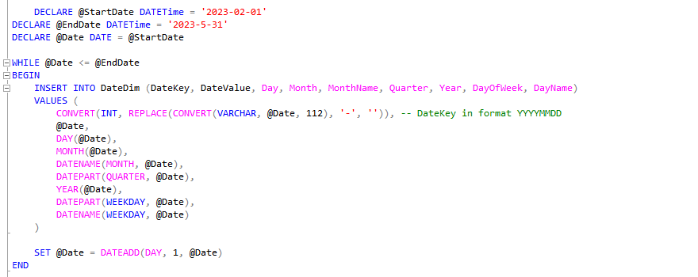
Queries of creation Table of DWH
Declare Variables and use While loop to create our date from 1-2-2023 to 31-5-2023 as said in Assessment PDF “This File from Feb to May”

Slide 13
Queries of creation Table of DWH
Alter Table of Date Dim To add new Column Named ”Id” to be a foreign key of The primary key “ID” in Sales fact Table
Then update Date Dim Table with Id’s where our Transaction Date meet Date Value (Used Cast Fun to convert date in transaction time and date value”

Slide 14
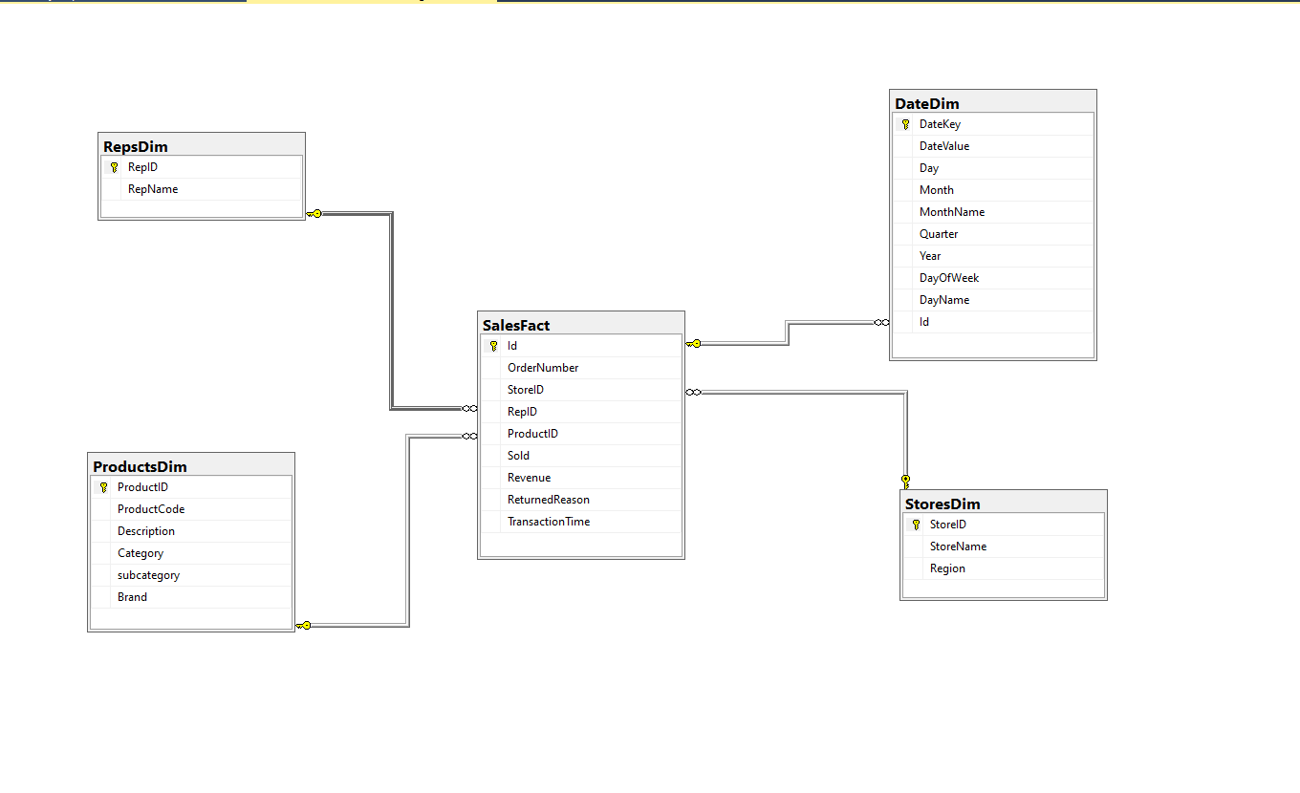
Diagram of DWH

Slide 15
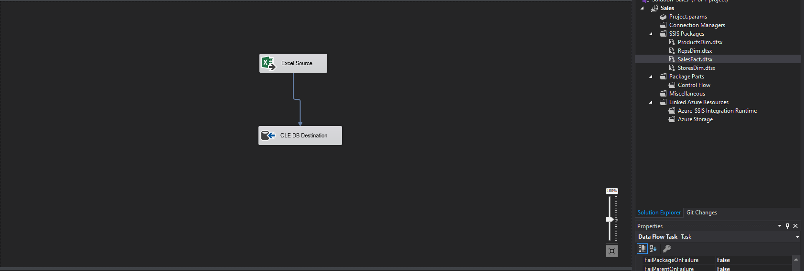
ETL pipelines from Excel File to DWH
Excel sheet Sales to DWH Sales Fact Table

Slide 16
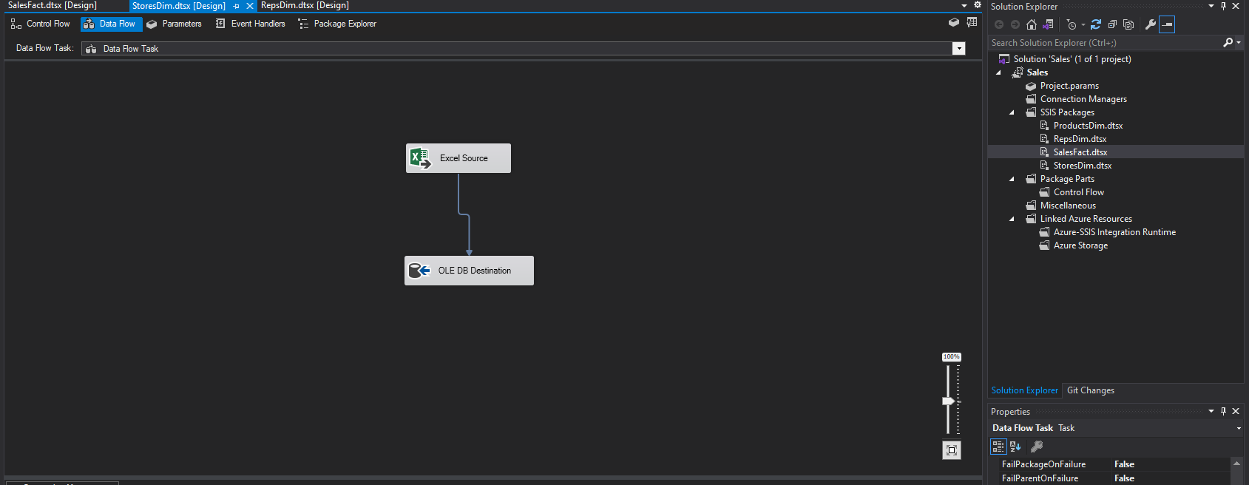
ETL pipelines from Excel File to DWH
Excel sheet stores to DWH Stores Dim Table

Slide 17
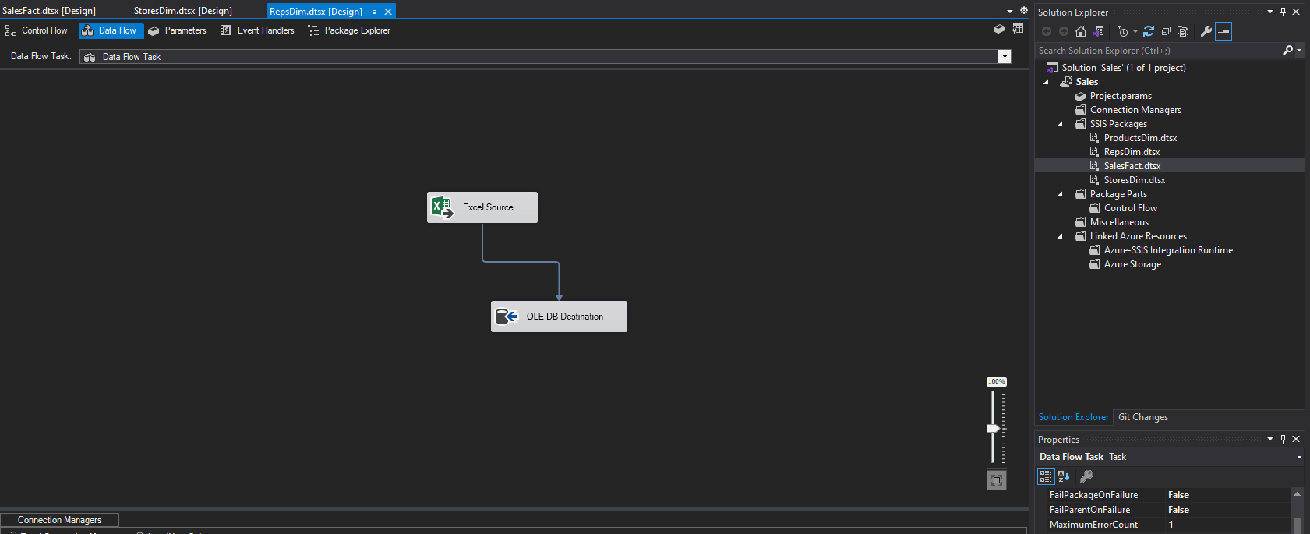
ETL pipelines from Excel File to DWH
Excel sheet Reps to DWH Reps Dim Table

Slide 18
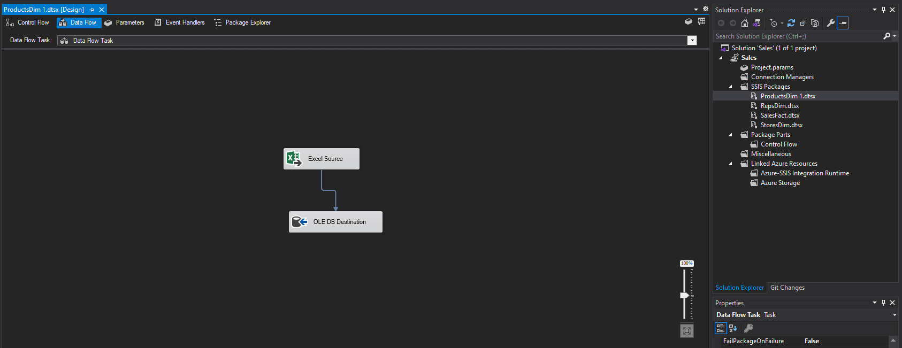
ETL pipelines from Excel File to DWH
Excel sheet Products to DWH Products Dim Table

Slide 19
Power BI Process

Slide 20
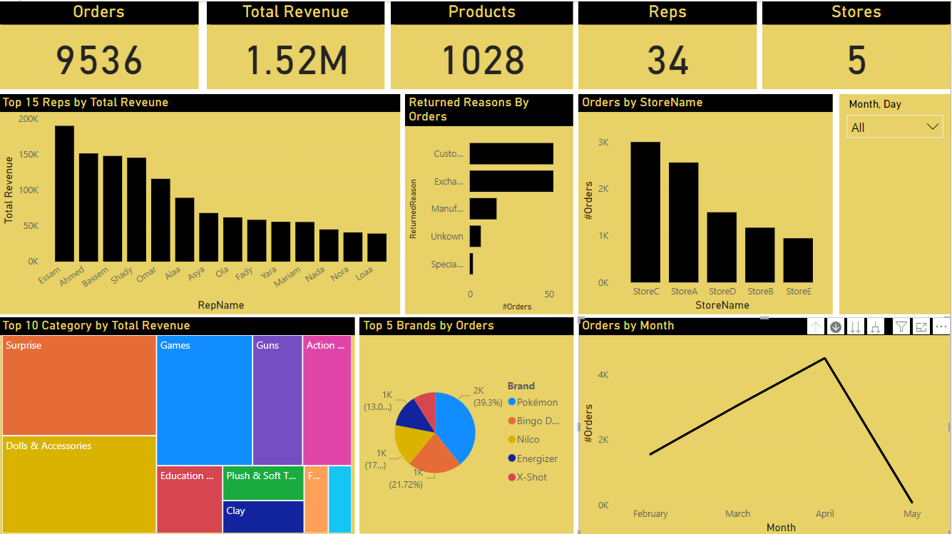
Power BI Dashboard

Slide 21
Power BI Dashboard
In This Dashboard
1.Cards That Describe our business
Orders : Counts of Orders
Total Revenue: Revenue of our company in these months
Products : Count of Products in our Stores
Reps : Number of our Reps
Stores : Number of Our Stores
2. Insights that help us to understand our business
Top 15 reps by Total revenue : Most 15 reps that achieve revenue to our company
Returned Reasons by orders : Returned Reasons and number of orders for each reason
Orders by store name : Count of orders for each store and compared between them column chart
Top 10 Category by Total Revenue: Top 10 Categories of product that achieved most revenues
Top 5 brands by orders: Top 5 brands our customers bought product from
Orders by month : Count of orders for each month and compare between months with line chart
Date Slicer: To make all insights and cards interactive with date that I want

Slide 22
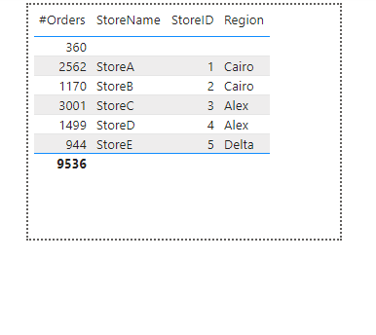
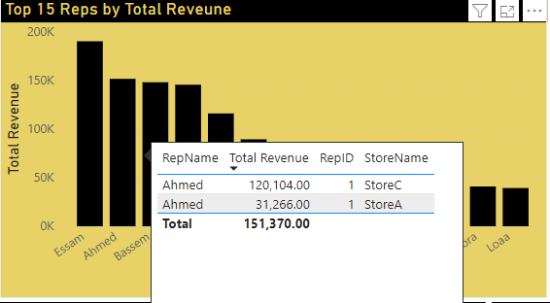
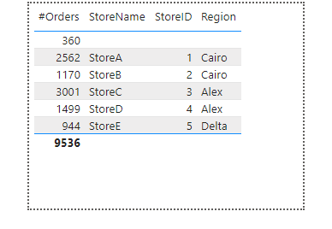
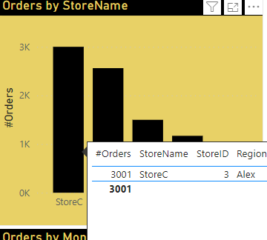
Power BI Dashboard
More Features : -
ToolTips for Insights to show more info
Reps Tooltip page
Stores Tooltip page

Slide 23
Thank You

